Slide 1
1. Project Name and one sentence introduction of your project
Project：D-TRUSTS Distributed Data Trust
We hope to create a distributed data trust management ecology with global influence through opening the “Pandora’s box” of data value sharing, circulation and realization, building a modern interconnective hub within the field of data value.
分布式账户体系

Slide 2
2. Introduction of your product
Project introduction：
D-TRUSTS is a distributed data trust product developed based on block chain technology and IPFS platform, which constantly brings us a huge data amount and a very complex data structure during the process global digital migration and the proceeding of the country’s new capital construction strategy to the digital world of 2077. On the one hand, a huge data resource is generated, while on the other hand, realistic problems such as data authentic right, isolated data islet hoard and data privacy, etc., also restrict the realization of data value and the formation of data cooperation network.
D-Trusts provides a set of prospective distributed data trust solution for data resources based on block chain, private calculation and intelligent contract, proposing a creative frame system for the ownership, right to use, right to earnings and operation power of data within legal and compliant law frames, meanwhile leading life-cycle management of data resources, which protects data privacy and security, returns the ownership and inheritance right of data to users, and makes the life cycle management as well as value of data orderly, bringing support of currency pricing to the value chain of data meanwhile enabling data to gain profits.
Project highlights：
1、Opens our imagination space to serve for global data market based on IPFS
distributed storage platform.
2、Brings a creative framework, provides solutions for the ownership, right to use, right to earnings and operation power of data within legal and compliant law frames.
3、Countless individual data intersections are generated in public social space, including communities, streets, stations and family data before divorce, etc., whose authentic right is of a high difficulty and cost. We provide creative solutions for the value of data in the above fields to be flowing, cooperative and realized with the premise of privacy protection.
4、Realize life-cycle management of data and the finding of data value based on privacy calculation in the pure block chain with protection of privacy security and data ownership throughout the whole process.
5、Model innovation, value sharing and intelligent contract of data account are integrated.

Slide 3
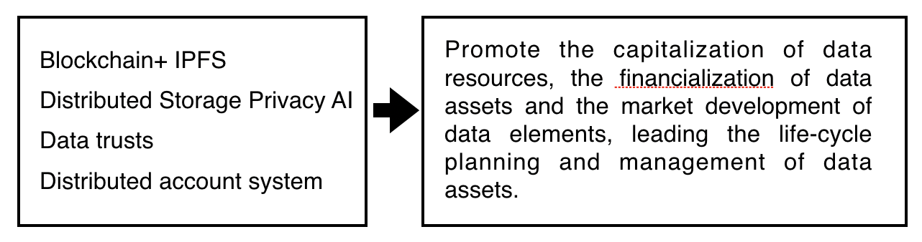
Project solution scheme and path

Slide 4
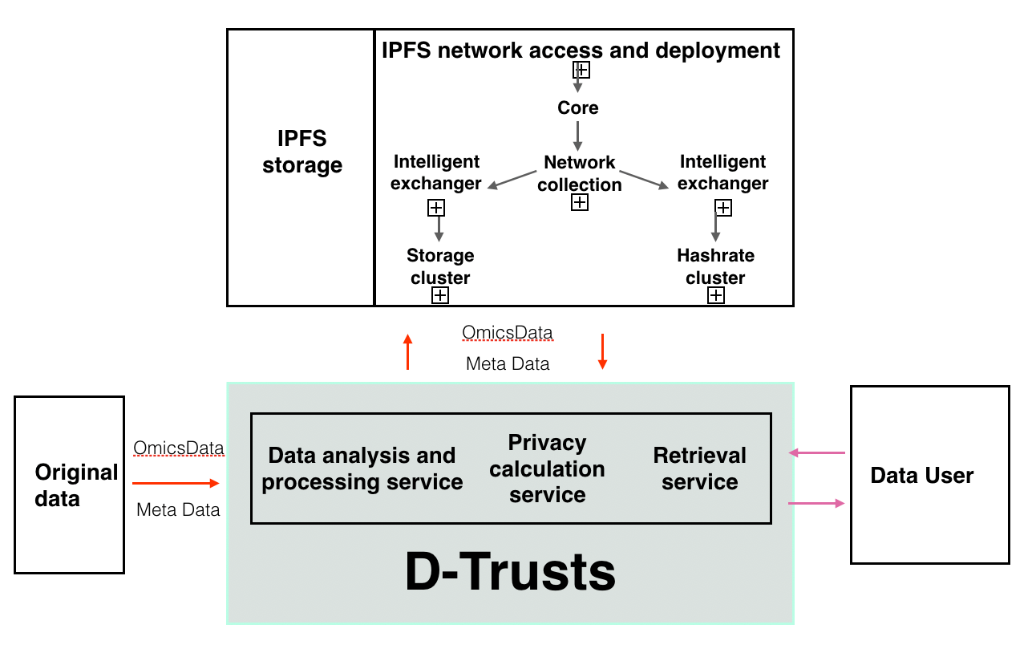
3. How is your product integrated with IPFS/Filecoin
Through connecting to the IPFS network, a network collection, a computer collection and a memory machine collection are formed by D-Trusts, forming data assets in IPFS after encrypting the original data, and information including the storage behavior as well as data fingerprint, etc. is stored in the block chain.
The data user applies for authority from D-Trusts, after obtaining which D-Trusts gains data through intelligent contract and API interface from IPFS and stores it in the privacy calculation platform. The data is privately calculated based on the demand of data user, and the calculation result obtained is returned to the data user.
As a data storage hub, relying on the advantages of IPFS distributed storage, IPFS has become an indispensable infrastructure. As there is a consensus of globalization in IPFS, it also brings a natural driving force for us to gain global customers and expand global business scenes.
During the use process of IPFS, its infrastructure has brought us a high efficiency/ convenience/ privacy.
IPFS will delete repeated data from the whole network, thus saving a large amount of bandwidth and resources.
IPFS supports humanized naming for data through IPNS
Establish a permanent information file: IPFS provides a weak-redundancy and high-performance clustering storage scheme. Set an information file that can be remembered by the world forever.
Reduce the cost of storage and bandwidth: IPFS provides a safe point-to-point content distribution network, which also saves bandwidth for large-amount data.
Perfectly integrated with block chain: process a large amount of data through IPFS, place unchangeable and permanent IPFS links in the block chain instead of the data itself.
Bring free and independent spirit for data owners, helping users to deliver the content in a disintermediate way.

Slide 5
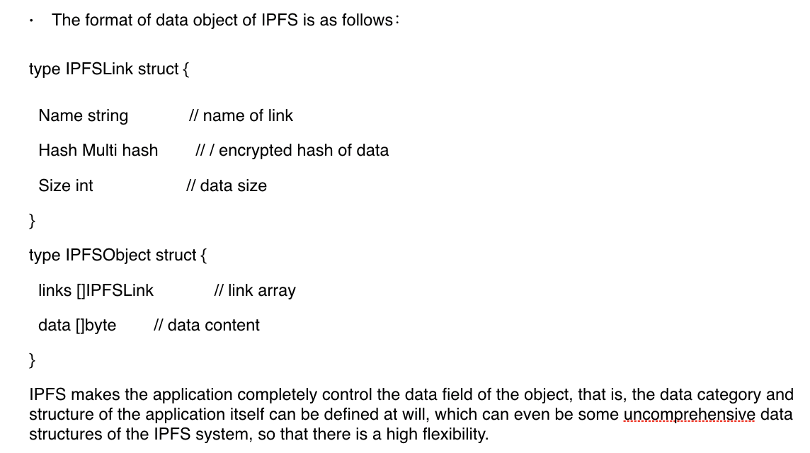
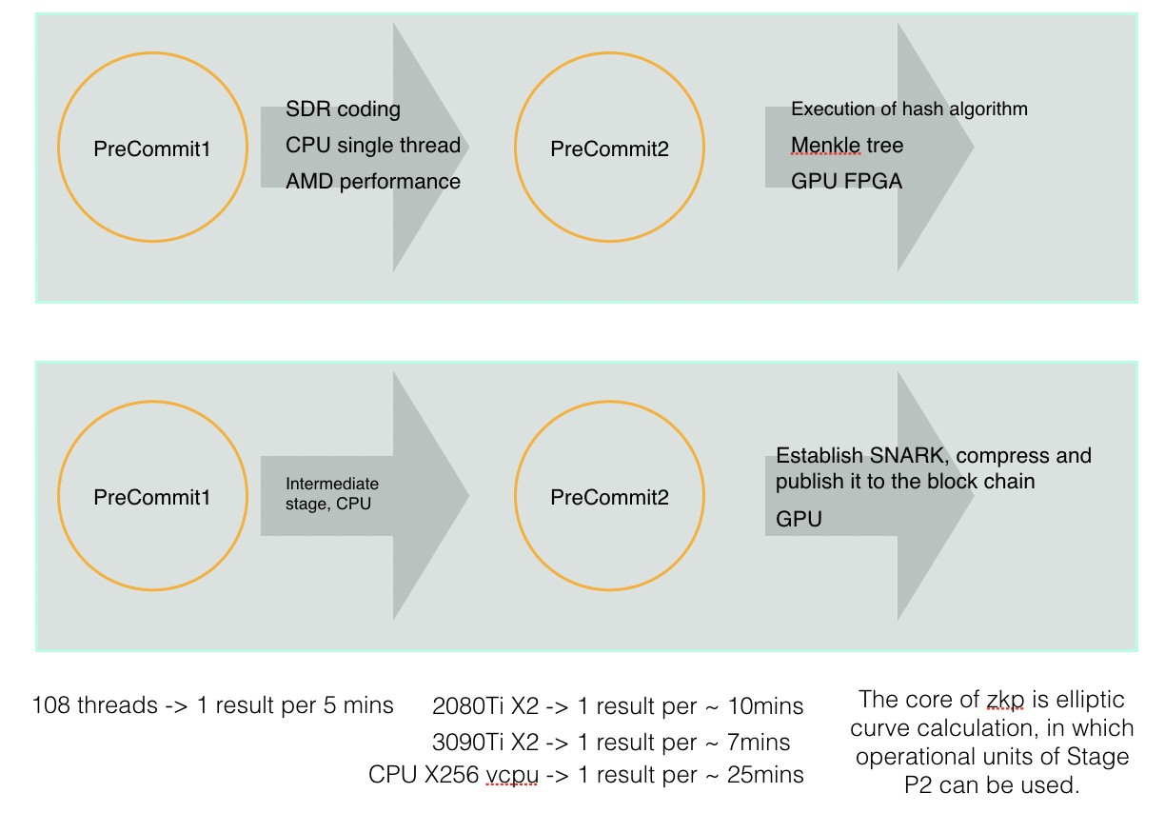
Data structure using IPFS
IPFS saves a large amount of bandwidth and resources for the whole network
Each document has its unique hash value, which can also be understood as the finger print. The other advantage of defining content with hash value is that repeated data can be automatically deleted. When several people are publishing the same document on IPFS, the data related will be generated once only, which makes the network efficiency extremely high and avoids the waste of resources.
Analysis of storage process of IFPS
IPFS is mainly dominated by mechanisms related to PoRep and PoSt.
PoRep is composed of several stages, and the demand of PoS process and PoRep resource is the same.

Slide 6
4. Where is your idea from?
Our vision is to create a distributed data trust management ecology with global influence, establishing a modern interconnective hub in the field of data value. Our inspiration comes from a kind of hope– we hope to open the “Pandora’s box” of value sharing, flow and realization.
Its commercial framework comes from basic policies of China’s territorial resources, which are collectively owned by the country, whose ownership belongs to the country. Local governments are allowed to authorize citizens and enterprises to operate and contract in the form of contracting based on actual situations, and should decide the price. In the whole framework, the ownership, right to use, distribution power, right of management and right to earnings are separated. Such a basic state policy has been a great success in the past 30 years, during which territorial, human and currency resources have been efficiently used.
The ambiguous data property right is the most serious problem faced by social digitalization and digital capitalization. If the value of data is to be made flow, the problem of data property right is the first question we will face. We gain inspiration through basic policies of territorial resources, hoping to design a kind of data governance framework to separate the ownership, right of management, distribution power, right to use and right to earnings of data, enabling the value of data to be fully exerted, coordinated and traded sufficiently all over the world.
IPFS enables us to take the first step of practice.
We hope that an interconnective hub of data value could be formed in the world through our product, and the core base to realize the above path is distributed storage, with which we can take the first in the realization of our vision. The storage network platform of IPFS step gives us such value, with distributed storage, we can realize the value of data through the storage of IPFS network, data transmission and privacy calculation after data encryption.

Slide 7
5. Any website, social media you want to loop into our community？
IPFS is home to a vibrant, diverse community of thousands of contributors and participants from all over the globe!
Chinese developers in our team hope to join in the activities of Chinese communities of PFS/Filecoin at ordinary times, meet more community partners and developers as well as introduce our progress and efforts to the whole world.
D-Trusts scheme can be exposed to platforms of PFS/Filecoin including Twitter and Meta, and our vision can be seen by more people with the influence of those communities.
6. Team background
Team members are core developing and designing personnel from WXBLOCKCHAIN and Alibaba Group, who have many years of experience in developing and have led the implementation of several platform-level products.
Sijianwu Monetary Banking, Shanghai University of Finance and Economics. Serves for several WXBLOCKCHAIN HACHTHON & GLOBAL VLOCKCHAIN SUMMIT for successive years, the first applicant of several invention patents of WXBLOCKCHAIN, whose work content covers several product lines.
Dora Computer Science at Shanghai Jiaotong University. The current senior core developer of Alibaba Group. He once worked for Wanxiang Blockchain, and led the development and implementation of multiple platform products, as a senior project manager, etc.
LIZ Computer Science, Shanghai Jiaotong University. He once led multiple product lines under the HASH KEY Group and served as the senior project manager of Hashkey Pro, Prometheum and other projects. Expert in the field of blockchain bottom layer, distributed storage, and smart contract.

